Slide 1
EDS/SOC 117
Week 2, Thursday
Culture, diversity, and the language of inequality

Slide 2
Recap from tuesday
Negative beliefs about cultural differences or diversity influence schools, teachers, and students
Ideas about “difference,” and that differences, particularly ideas about racial differences are a social construction and not a biological fact
The meanings of differences change over time, just as language changes over time as the societal context changes

Slide 3
Longstanding Conversation in Social Science: What Determines Our success or failure?
Institutions in society
Individual choice, free will
Economic
Health
Education
Social
Legal
Political
Religious
Etc.
Family
Self
Neighborhood
Friends
School
Peers
Church
Etc.
LIFE
What role does education play in shaping our pathways in life?

Slide 4
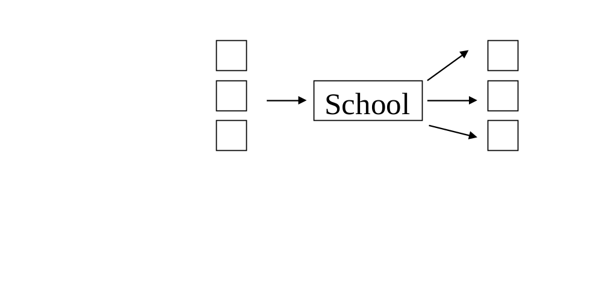
View #1: Schools as provider of equal opportunity
High income
Middle income
Low income
Family Background
Occupation

Slide 5

View #2: Schools reproduce social inequalities (Economic model)
School
High Income
Middle Income
Low Income
Family Background
Occupation

Slide 6
HOW SCHOOLS RESPOND TO STUDENTS’ BACKGROUNDS
Social class background is very important, but there are other factors that influence students’ experiences in school, their learning and achievement.
What about culture, language, gender, race or ethnicity?
How schools influence students is much more complicated.

Slide 7
Case study: Linda Howard
1. What does culture mean for Linda? Does her view of herself match how others view her?
2. She thinks “we’re all racist in a sense.” Do
you think there’s some truth to this?
3. One of her teachers said she can go to Harvard and talk with people, and she can go out in the street and “rap with y’all.” Linda loves this – having her “street talk” and being able to “talk properly.” This reflects perceptions about language and being successful. Why is Linda’s view important?

Slide 8
Case study: rich miller
1. Rich has a strong sense of self instilled by his mother who pushes education. Yet, his experiences in society and in a mostly African American school contradict this message. Discuss his school experiences and how they influenced how he sees himself as a student.
2. Even with a strong identity, Rich shares some negative perceptions about his race. How have these negative perceptions affected him?
3. What do you think he means by, “Self-respect is one gift that you give yourself?

Slide 9
Case study: Vanessa Mattison
1. Vanessa seemed uncomfortable discussing racial, class or cultural differences. Her approach was that differences are not important – the “color-blind” approach. Why is this approach harmful to all students?
2. The author (Nieto) writes that research shows that Whites students are much less likely than students of color to identify ethnicity as important to their identity. Why do you think that’s the case? Are there exceptions?

Slide 10
What Determines Success?
?
?
?
UCSD

Slide 11
What Has Influenced Your Pathway to College?
Take a few moments to think about your life and what influenced your pathway to UCSD.
First, jot down influences that helped you – persons, places, things, events, opportunities, programs, resources, etc. List all things “big” and “small.”
Second, re-read your list of influences. Pick the top 3 influences that were the most important, then write about why you selected the 3 influences.

Slide 12
What is culture?
Take a moment to jot a few lines on your paper about “culture.”
What is it? Where does it come from?
What is NOT culture?

Slide 13
NIETO READING ON CULTURE
“Culture as the ever-changing values, traditions, social and political relationships, and worldview created, shared, and transformed by a group of people bound together by a combination of factors that can include a common history, geographic location, language, social class, and religion.”
“Culture is complex; it includes content or product (the what of culture), process (how it is created and transformed), and the agents of culture (who is responsible for creating and changing it). Culture cannot be reduced to holidays, foods, or dances, although these are, of course, elements of culture. This definition also makes it clear that everyone has a culture.”

Slide 14
NIETO READING ON CULTURE
Culture is not inherited through genes. Culture is learned; it is a human creation
Culture is dynamic and always changing
Cultural change is a two-way process, meaning cultures are always hybrids

Slide 15
NIETO READING ON CULTURE
People select and reject particular elements of culture as suitable or not for themselves or particular contexts
Culture is multifaceted - cultural identifications are multiple, eclectic, mixed, and heterogeneous. Culture cannot be equated with just ethnicity or race.

Slide 16
Culturally Mediating Factors
  Family values, beliefs, traditions (food, clothes, music)
  Peers/friends
  Race/ethnicity
  Gender/sexuality
  Religion
  Economic/social class background
  Language background
  Personal desire, effort and aspirations
  Community/neighborhood/geographic location
  School
  Home-school relationships
  Media and technology
  Anything else?

Slide 17
culture and poverty
  Longstanding tradition in sociology of studying the role of culture in education
  Sociologists have studied connections between culture and a range of social issues in society - poverty, immigrant experiences, tensions/conflicts among ethnic and religious groups, etc.
  (Small, M. et. al. (2010). Reconsidering Culture and Poverty. The ANNALS of the American Academy of Political and Social Sciences, Vol. 629, No. 6.)

Slide 18

M. Small, et. al., “Reconsidering culture and poverty”
Why study culture?
  Understand how people cope with challenges
  Understand why people in similar socio-economic circumstances experience different outcomes in education and in life (e.g., jobs/careers)
  Combat myths about economically disadvantaged groups
  Clarify what we mean when we use the term culture
  Create and implement better policies
  Recognize underlying cultural beliefs in policy debates

Slide 19
M. Small, et. al., “Reconsidering culture and poverty”
  Some definitions that might be useful to think about culture:
    Values – typically represent the ends toward which behavior is directed; values can predict behavior
    Frames – lenses through which people observe and interpret life; people’s conceptions of “how the world works”
    Repertoires – a body or stock of strategies, actions; people are unlikely to engage in an action unless they already have a strategy in place to carry out that action

Slide 20
M. Small, et. al., “Reconsidering culture and poverty”
    Narratives – people interpret their lives as stories that have a beginning, middle and end; people make sense of their lives through stories about personal experiences
    Symbolic Boundaries - conceptual distinctions people make between objects, people and practices; they create a hierarchy of groups and the similarities or differences between them.

Slide 21
How do we access knowledge about culture?
Culture is often invisible, therefore...
We need to cultivate an alienated perspective by making the “familiar strange”

Slide 22
Schools have a distinct Culture
  The tone, character or climate of a school through:
  Physical layout of the school. Condition of buildings, classrooms, equipment, bathrooms
  School routines for keeping order – entering/leaving procedures, lunch privileges, discipline, the “hall pass”
  Grouping students for instruction – ability grouping (honors, AP, regular, remedial) and the quality of assignments
  Expectations of students – available programs and resources, curriculum, teaching, relationships with school adults, views of students, wall decorations
Notes:
Cultural patterns in educational settings…

Slide 23
Culture of schooling in the U.S.
Guiding cultural assumptions of many US schools:
  All students vary in ability.
  Ability is relatively fixed, unchangeable and can be accurately measured.
  There is a hierarchy of skills to be learned in content areas, in a set order.

Slide 24
Impact of school culture on students
Think about your own schools:
How might school culture impact students’ experiences in school?
For example, their opinions about education, their participation in school and in the classroom, their learning and achievement?

Slide 25
Beliefs about STUDENTS
Consider ideas about being “normal”
How did your schools define what it means to be a “normal” student?
What cultural beliefs are underlying those definitions?

Slide 26
Beliefs about STUDENTS
Consider ideas about being “smart”
How did your schools define what it means to be a smart student?
What cultural beliefs are underlying those definitions?

Slide 27
Beliefs about STUDENTS
In your schools, when a student was considered to be a “bad” student, what did that mean?
What cultural beliefs are underlying those definitions?
Notes:
.

Slide 28
Beliefs about STUDENTS
In your schools, when a student struggled academically or failed, how did people explain or talk about that student’s struggles?
What cultural beliefs are underlying those definitions?

Slide 29
reminders
Self-selection for discussion groups during Thursday’s lecture – email me the names by Sunday, January 20th (not the same as discussion section)
Tuesday’s readings – challenging writing style of Bereiter & Engelmann. Pay attention to the overall main points and evidence they use to back up their argument.

